Slide 1


Module 3. Lesson 3.
The Smart Notes Application. P. 2
Link to methodological guidelines

Slide 2

Module 3. Lesson 3. The Smart Notes Application. P. 2
Discussion:
The Smart Notes Application

Slide 3
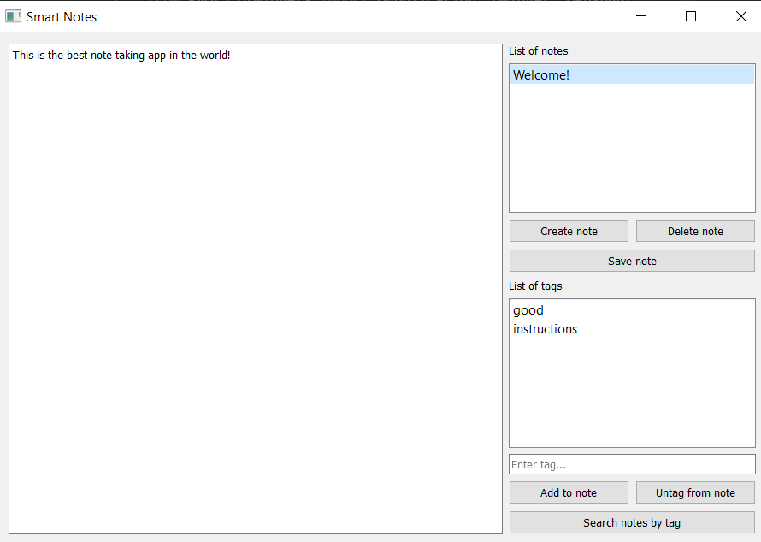


Let’s continue working on our order!
The Scientific Institute of Theoretical Physics has made an order for a “Smart Notes” application.
Last time, we:
created the “Smart Notes” interface
created the
json file notes_data.json
added the first note to the json file
Discussion
of work tasks
Cole,
Senior Developer

Slide 4
Tasks for today
Creating, saving, deleting notes.
Discussion
of work tasks
Adding a tag to or unclipping it from a note.
Searching for notes by entered tag.

Slide 5
To accomplish these tasks, we need to know:
how to display the data from a selected note;
how to organize the making of changes to the notes dictionary and the json file;
how to clear list widgets and fields;
how to search for notes by tag.
Discussion
of work tasks

Slide 6
The goal of this workday is
to program the application interface and organize the storage of notes in a json file.
Today you will:
Discussion
of work tasks
Learn about the structure of a json file — a file with a built-in data structure.
Program the application interface.
Upload your first smart note.

Slide 7

Module 3. Lesson 3. The Smart Notes Application. P. 2
Qualification

Slide 8
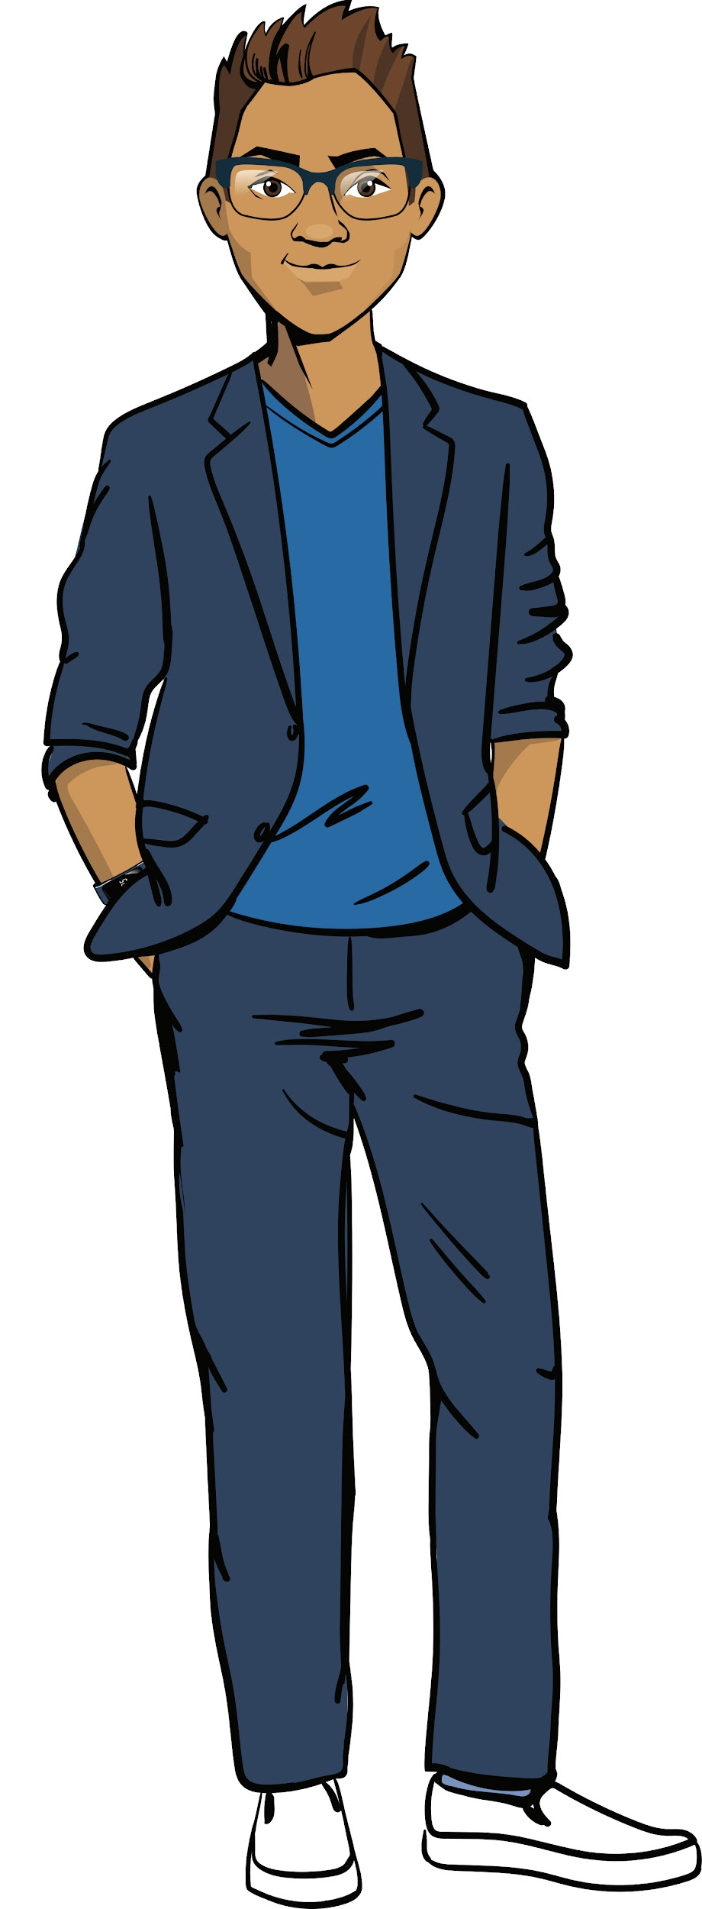
Demonstrate your knowledge
of the PyQt library and how to work with text files
Qualification

Slide 9
What is a json file?
Qualification

Slide 10
A file in the json format
is a text file for storing structured data.
Qualification
The structure of a json file is very similar to a dictionary of dictionaries in Python.

Slide 11
Which command opens a json file for reading? How about for writing?
Qualification

Slide 12
Opening a json file for
reading and writing:
Command | Purpose
with open("f.json", "r") as file: | Open a json file for reading
with open("f.json", "w") as file: | Open a json file for writing
Qualification

Slide 13
Which command loads data from a json file?
Which command records data in a json file?
Qualification

Slide 14
Loading and recording data in a json file:
Command | Purpose
data = json.load(file) | Load a structure from a json file into data dictionary
json.dump(data, file) | Load a structure from data into a json file
Qualification

Slide 15
Writing the notes dictionary into a json file:
Command | Purpose
with open("f.json", "w") as file: | Open a json file for writing
json.dump(notes, file) | Load a structure from data into a json file
Qualification

Slide 16
How can we sort a dictionary’s keys as we write it into a json file?
Qualification

Slide 17
Sorting a dictionary’s keys while writing it into a file:
with open("notes_data.json", "w") as file:
json.dump(notes, file, sort_keys=True)
{
"About space" : {
"text" : "Is there extraterrestrial life?",
"tags" : ["life", "space"]
},
"Astronauts" : {
"text" : "Gagarin’s courage is an example to us all!",
"tags" : ["astronauts"]
}
}
{
"Astronauts" : {
"text" : "Gagarin’s courage is an example to us all!",
"tags" : ["astronauts"]
},
"About space" : {
"text" : "Is there extraterrestrial life?",
"tags" : ["life", "space"]
}
}
Qualification
notes dictionary
file: notes_data.json

Slide 18
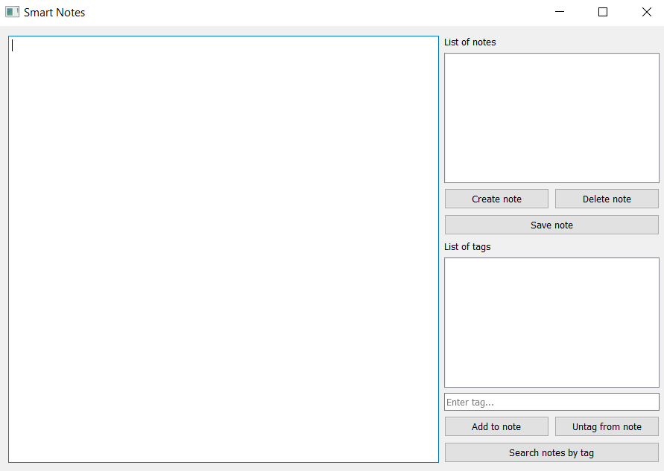
Name these widgets:
?
?
Qualification
?
?

Slide 19
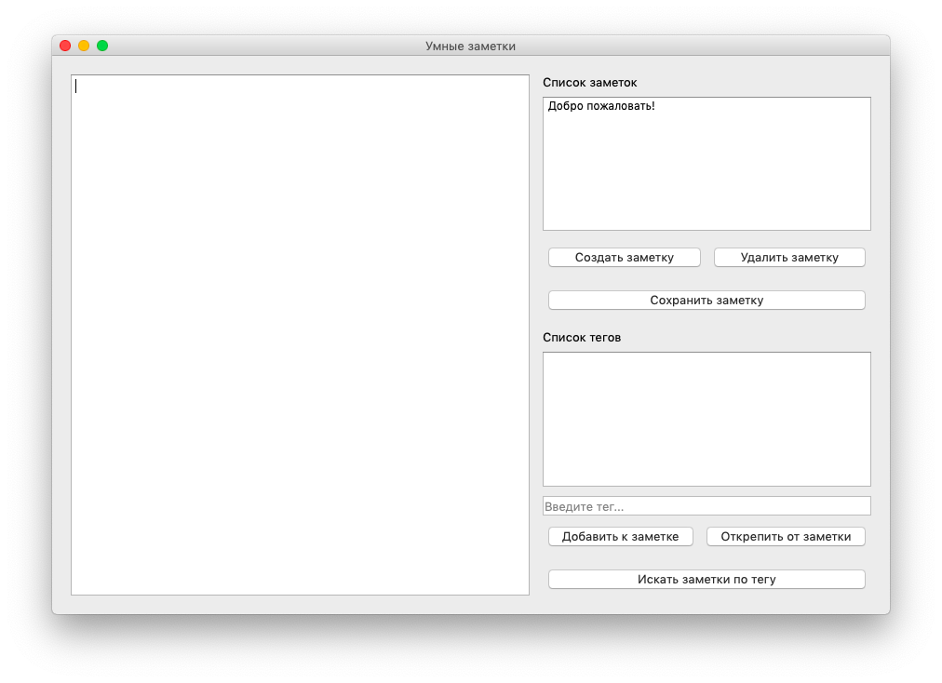
Name these widgets:
QListWidget
QTextEdit
Qualification
QPushButton
QLineEdit

Slide 20

Which command will change the text in this widget?
#creating a button without text
button_save = QPushButton(
'Save note'
)
#write the label
#“Save text”...
QPushButton
Qualification

Slide 21
The command to change the text in this widget:
#creating a button without text
button_save = QPushButton(
'Save note'
)
#the label “Save text”
button_save.setText(
'Save text'
)
QPushButton
Qualification
By the way, the button_save.text() method returns a line with the widget’s label.

Slide 22
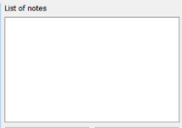
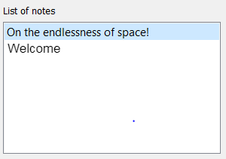
Which command will add elements to a widget? Which one will clear a widget’s contents?
Qualification
?
QListWidget

Slide 23
Adding and removing a set of elements:
list_notes.addItems(notes)
Qualification
list_notes.clear()

Slide 24
How do we handle the mouse click of an element in the list?
In “Smart Notes”, clicking the name of a note should cause the text and tags to be displayed.
Qualification

Slide 25
Handling the mouse click of an element in the list:
def show_note():
list_notes.itemClicked.connect(show_note)
THE FUNCTION ITSELF IS DESCRIBED SEPARATELY
Qualification
THE NAME OF THE HANDLER FUNCTION CALLED BY THE BUTTON
*In the same way, each button needs its own handler functions.

Slide 26
Qualification confirmed!
Excellent, you are ready to brainstorm and tackle today’s task!
Qualification

Slide 27

Module 3. Lesson 3. The Smart Notes Application. P. 2
Brainstorming:
Editing the
Smart Notes

Slide 28
All the tasks for Smart Notes:
Query a name
Enter text
Save a note
Assign tags
Enter tags for search
Result: list of notes
Delete a note
Creating a note
Searching the notes
Smart Notes
Brainstorming
Information about notes
List of tags for this note
When application launches
When note name is clicked
List of existing notes
Note text

Slide 29
Current tasks:
Query a name
Enter text
Save a note
Assign tags
Enter tags for search
Result: list of notes
Delete a note
Working with a note
Searching the notes
Smart Notes
Brainstorming
Information about notes
List of tags for this note
When application launches
When note name is clicked
List of existing notes
Note text
— current task
— completed
— not completed

Slide 30
Current tasks:
Working with a note
Create note
Save note
Delete note
How to program?
Brainstorming
?
?
?

Slide 31
Current tasks:
A button is clicked...
“Create note”
“Save note”
“Delete note”
Brainstorming
The widget button_add_note calls the function add_note
The widget button_save_note calls the function save_note
The widget button_del_note calls the function del_note
1.
2.
3.

Slide 32
Let’s look at creating a note:
Click the button “Create note”
def add_note begins working
Query note name
Result: empty note with queried name
Brainstorming
Read and save text
Happens in the function
def save_note
Attach tags
Tags are handled by lower panel of buttons

Slide 33
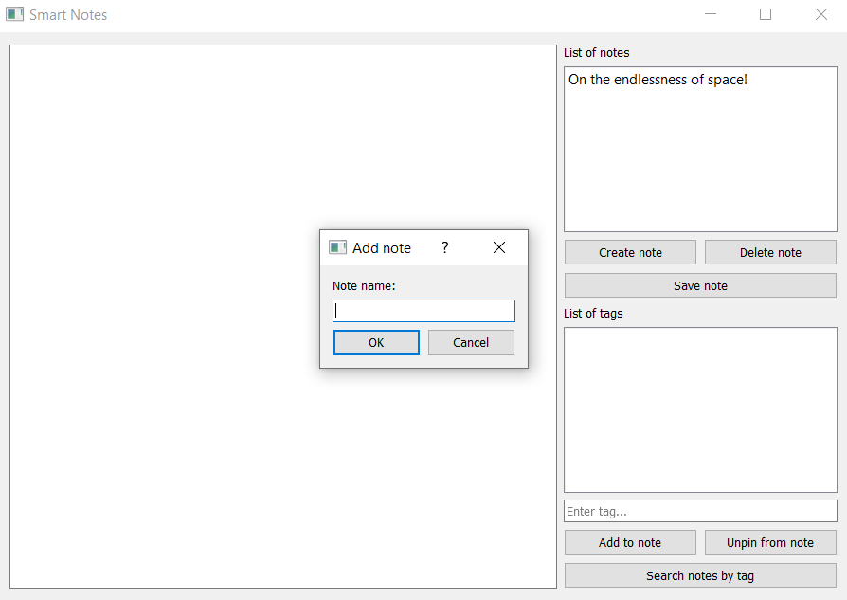
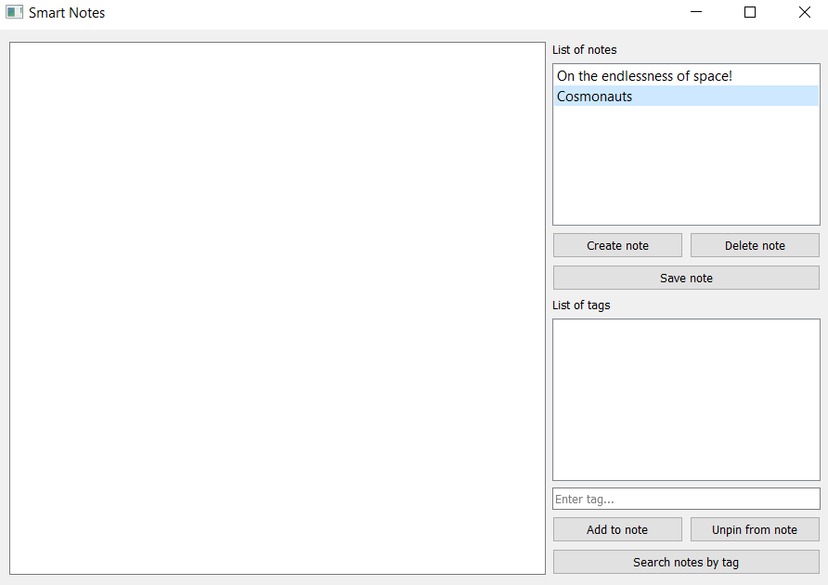
The add_note function:
Brainstorming
The name of the note is queried in a separate window QInputDialog.
2. An empty note with the queried name is created and appears in the list of notes.

Slide 34
The QInputDialog window:
Command | Purpose
from PyQt5.QtWidgets import QInputDialog | Import a widget
note_name, ok = QInputDialog.getText(...) | Create a QInputDialog window with the name note_name and read the text from the entry field
Brainstorming
Note:
QInputDialog is similar to a widget you already know: QMessageBox. The new widget not only shows the window with the text, but prompts the user to Enter text.

Slide 35
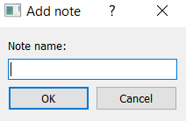
The QInputDialog window:
Example:
note_name, result = QInputDialog.getText(
notes_win, "Add note", "Note name:"
)
Result:
Brainstorming
The input text will end up in the variable result

Slide 36
We need to program:
def add_note():
'''Asks for the name of the new note and creates an empty note with this name'''
asks for the name of the note through the QInputDialog window.
creates a notes element with the given name. The text and tags for this note are empty.
the name of the new note is displayed in the list_notes list.
Brainstorming

Slide 37
We need to program:
def add_note():
note_name, ok = QInputDialog.getText(
notes_win, "Add note", "Note name: "
)
if ok and note_name != "":
notes[note_name] = {"text" : "", "tags" : []}
list_notes.addItem(note_name)
#list_tags.addItems(notes[note_name]["tags"])
Exploring
a new topic

Slide 38
2. Let’s consider deleting a note:
Delete a note from data
Delete a note from widgets
Select a note from the list_notes list
Delete an element from the notes dictionary
Delete the name from the list_notes list
The button “Delete note” is clicked
Write updated notes dictionary to file
Delete the text from field_text
Brainstorming
def del_note begins working
Delete the tags from list_tags

Slide 39
2. Let’s consider deleting a note:
Delete a note from data
Delete a note from widgets
Select a note from the list_notes list
Delete an element from the notes dictionary
Delete the name from the list_notes list
The button “Delete note” is clicked
Write updated notes dictionary to file
Delete the text from field_text
Brainstorming
def del_note begins working
Delete the tags from list_tags
Note: if a note to be deleted has not been selected, we can display a message to the console: “No note selected!”

Slide 40
We need to program:
def del_note():
'''Deletes the selected note from the notes dictionary, from the file and widgets.'''
If a note is selected from list_notes, then:
remember the name of the selected note;
delete the note from the notes dictionary;
rewrite notes to the file with the data;
delete the data about the note from the widgets (from the list of names, from the list of tags, from the text fields).
Brainstorming

Slide 41
3. Let’s consider saving a note:
A note is selected from the list_notes list
The text from field_text becomes the text of the selected note
Now when this note is selected, the saved text will be displayed
The button “Save note” is clicked
Updated notes dictionary is written to the file
Brainstorming
def save_note begins working
Note: if a note to be saved has not been selected, we can display a message to the console: “No note selected!”.

Slide 42
3. Let’s consider saving a note:
Save the data
Display on interface
A note is selected from the list_notes list
The text from field_text becomes the text of the selected note
Now when this note is selected, the saved text will be displayed
The button “Save note” is clicked
Updated notes dictionary is written to the file
Brainstorming
def save_note begins working
Note:
the field_text.toPlainText() method returns entered text from the field_text field

Slide 43
We need to program:
def save_note():
'''Saves text to selected note from the notes dictionary and updates data file'''
If a note is selected from list_notes, then:
get text from the widget field_text (toPlainText);
record the text in the notes note with the selected name;
rewrite notes to the data file.
Brainstorming

Slide 44
Tasks:
Create functions for creating, saving and deleting notes.
Handle clicks of the buttons “Create note”, “Save note” and “Delete note” using these functions.
Brainstorming

Slide 45
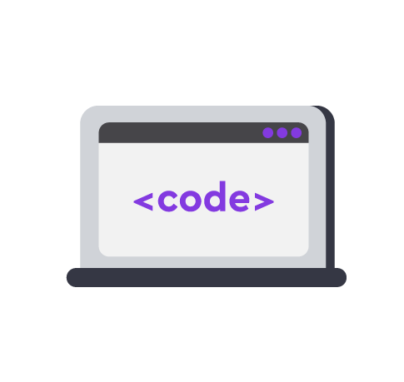
Module 3. Lesson 3. The Smart Notes Application. P. 2
Visual Studio Code:
The Smart Notes Application

Slide 46




Do the task in VS Code
“VSC. The Smart Notes Application”
VS Code
Working in VS Code

Slide 47
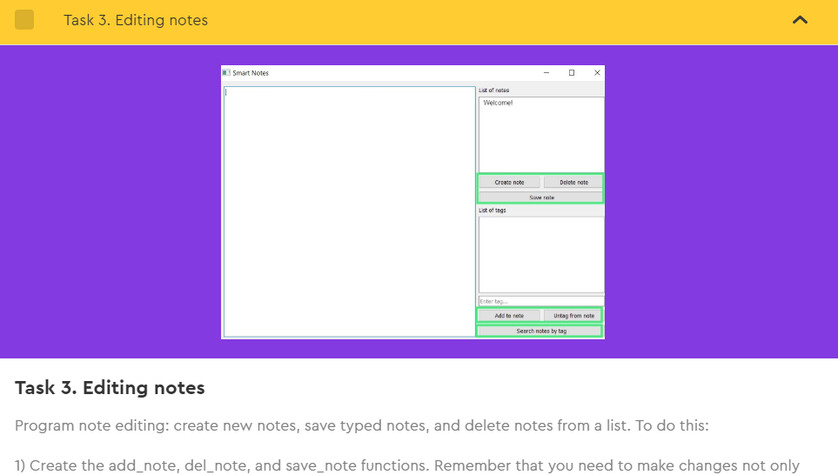
Do the tasks in VS Code
“VSC. The Smart Notes Application”
Complete
“Task 3.
Editing notes”.
Working in VS Code

Slide 48

Module 3. Lesson 3. The Smart Notes Application. P. 2
Break

Slide 49
Module 3. Lesson 3. The Smart Notes Application. P. 2
Brainstorming:
Working with tags
in Smart Notes

Slide 50
Current tasks:
Query a name
Enter text
Save a note
Assign tags
Read tags for search
Result: list of notes
Delete a note
Working with a note
Searching the notes
Smart Notes
Brainstorming
Information about notes
List of tags for this note
When application launches
When note name is clicked
List of existing notes
Note text
— current task
— completed
— not completed

Slide 51
Current tasks:
Searching for notes by tag
Attaching a tag to a note
Unclipping a tag from a note
Searching for notes with the given tag
How to program?
Brainstorming
?
?
?

Slide 52
Current tasks:
Searching for notes by tag
Attaching a tag to a note
Unclipping a tag from a note
Searching for notes with the given tag
Brainstorming
The add_tag function adds the tag to the list of tags for this note and updates the data file
The del_tag function deletes the tag from the list of tags for this note and updates the data file
The search_tag function leaves only the notes with the given tag in the list

Slide 53
Current tasks:
Searching for notes by tag
Attaching a tag to a note
Unclipping a tag from a note
Searching for notes with the given tag
“Brainstorm”
The add_tag function adds the tag to the list of tags for this note and updates the data file
The del_tag function deletes the tag from the list of tags for this note and updates the data file
The search_tag function leaves only the notes with the given tag in the list
Note: these functions are handler functions for a click of the widget button “Add to note” and others.

Slide 54
Let’s consider adding a tag:
A note is selected in list_notes
Adding the tag to data
Adding the tag to interface
There’s a tag in the field (not empty)
The tag is recorded in the list of tags for this note
Data for widget with list of tags is updated
Brainstorming
The “Add to note” button is clicked
Updated notes dictionary is written to the data file
Entry field for new tags is cleared
def add_tag begins working

Slide 55
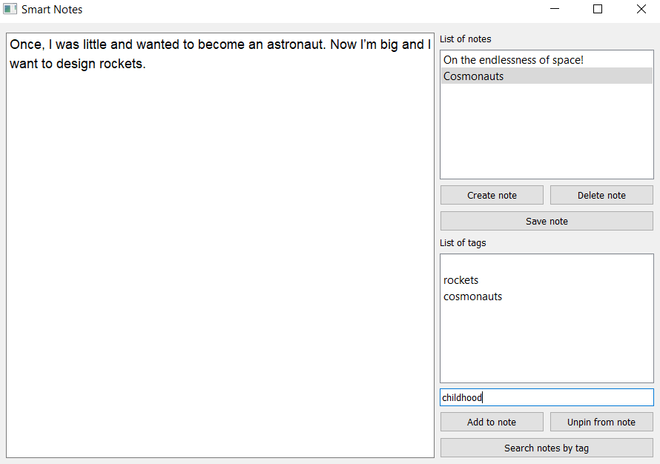
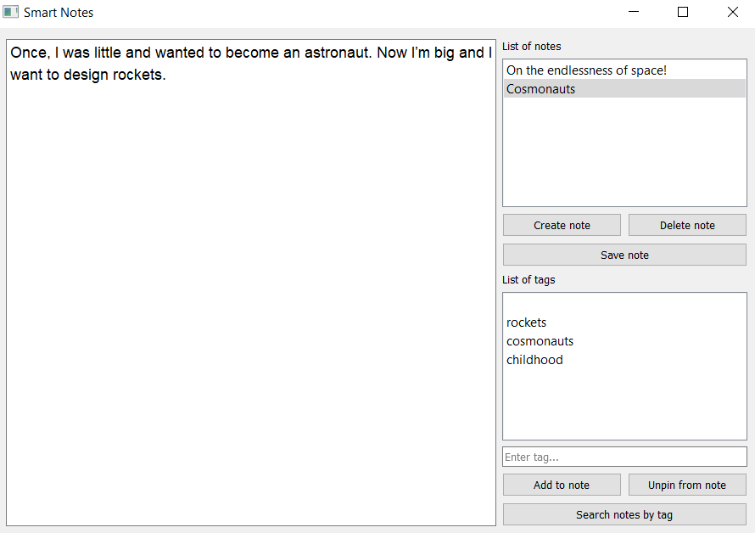
Let’s consider adding a tag:
Before
After
Brainstorming
When “Add to note” is clicked, the entered tag is displayed in the list of tags. The tag entry field is cleared so new data can be entered.

Slide 56
We need to program:
def add_tag():
'''Adds the entered tag to the list of tags for the selected note'''
If a note is selected in list_notes, then:
read the tag from the field_tag field.
If there is no such tag among the note’s tags, then:
add tag to notes[note][“tags”];
add tag to the tag list widget;
clear the tag entry field;
write the notes dictionary to the file again.
Brainstorming

Slide 57
We need to program:
def add_tag():
if list_notes.selectedItems():
key = list_notes.selectedItems()[0].text()
tag = field_tag.text()
if not tag in notes[key]["tags"]:
notes[key]["tags"].append(tag)
list_tags.addItem(tag)
field_tag.clear()
with open("notes_data.json", "w") as file:
json.dump(notes, file, sort_keys=True)
else:
print("No note selected to add tag!")
Exploring a new topic

Slide 58
2. Let’s consider deleting a tag:
A note is selected in list_notes
Deleting the tag
from data
Deleting the tag
from interface
A tag is selected in the list of tags
The tag is deleted from the list of tags for this note
Data for widget with list of tags is updated
Brainstorming
The “Unclip from tag” button is clicked
Updated notes dictionary is written into the data file
def del_tag begins working

Slide 59
We need to program:
def del_tag():
'''Deletes selected tag from list of tags for selected note'''
If a note is selected in list_notes:
delete the tag selected in the list of tags from the widget list_tags;
delete this tag from the list of tags for the current note notes[note][“tags”];
rewrite the updated notes dictionary to the data file.
Brainstorming

Slide 60
3. Let’s consider searching by tag:
Searching for notes by the tag
Clearing results for a new search
Search for notes with the entered tag
Clear the tag entry field
Tag for search is entered in the field
Create the dictionary notes_filtered with search results
Display full list of notes in list_notes
Brainstorming
The “Search by tag” button is clicked
def search_tag begins working
Display notes_filtered in list_notes instead of the full notes list

Slide 61
3. Let’s consider searching by tag:
Searching for notes by tag
Clearing results for new search
Search for notes with the entered tag
Clear tag entry field
Tag for search is entered in the field
Create the dictionary notes_filtered with search results
Display full list of notes in list_notes
Brainstorming
The “Search by tag” button is clicked
def search_tag begins working
Display notes_filtered in list_notes instead of the full notes list
How do we prompt the user to clear the search?

Slide 62
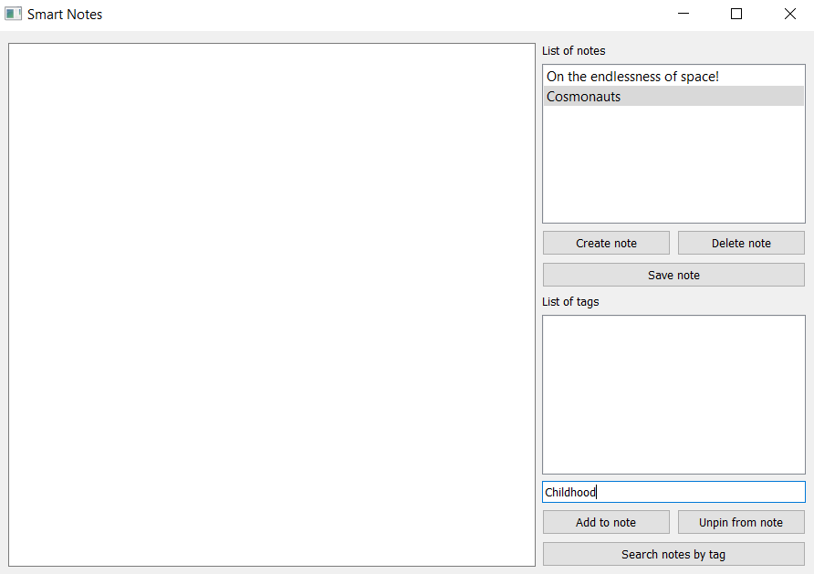
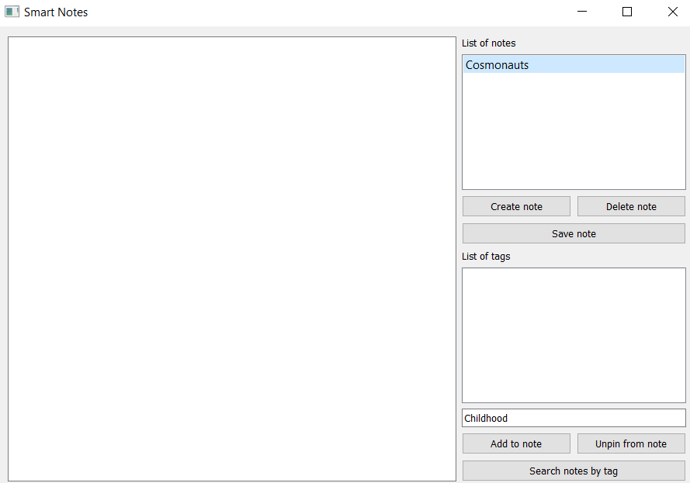
3. Let’s consider searching by tag:
Before
After
Brainstorming
After searching for notes by tag, the user is prompted to clear the search results (clear the entry field and display the full list of notes).

Slide 63
3. Let’s consider searching by tag:
Label on the button changes to “Search by tag”
Searching for notes by tag
Clearing results for new search
Search for notes with selected tag
Label on the button changes to “Clear search”
Tag for search is entered into field
The dictionary notes_filtered is created with the search results
The button “Clear search” is clicked
Brainstorming
The button “Search by tag” is clicked
Tag entry field is cleared
def search_tag begins working
Results displayed in list_notes (instead of the full notes list)
Full list of notes is displayed in list_notes

Slide 64
We need to program:
def search_tag():
'''Creates a list of notes that have the selected tag'''
If the “Search by tag” button is clicked:
read the tag from the entry field;
select from the notes dictionary only notes with the entered tag (notes_filtered);
display the resulting dictionary in list_notes;
change the name of the button to “Clear search”.
Brainstorming

Slide 65
We need to program:
def search_tag():
'''Creates a list of notes that have the selected tag'''
If the “Clear search” button is clicked:
clear the entry field;
show the full notes dictionary in list_notes;
change the name of the button to “Search by tag”.
Brainstorming

Slide 66
def search_tag():
tag = field_tag.text()
if button_tag_search.text() == "Search for notes by tag" and tag:
notes_filtered = {} #notes with selected tag will be here
for note in notes:
if tag in notes[note]["tags"]:
notes_filtered[note]=notes[note]
button_tag_search.setText("Clear search")
list_notes.clear()
list_tags.clear()
list_notes.addItems(notes_filtered)
elif button_tag_search.text() == "Clear search":
field_tag.clear()
list_notes.clear()
list_tags.clear()
list_notes.addItems(notes)
button_tag_search.setText("Search for notes by tag")
else:
pass
Exploring a new topic

Slide 67
Tasks:
Create functions for adding and deleting tags, and for searching for notes by tag.
Handle clicks of the buttons “Add to note”, “Unclip from note” and “Search for note by tag” using these functions.
Brainstorming

Slide 68
Module 3. Lesson 3. The Smart Notes Application. P. 2
Working in
VS Code

Slide 69
Complete the task in VS Code
“VSC. The Smart Notes Application”
VS Code
Working in VS Code

Slide 70
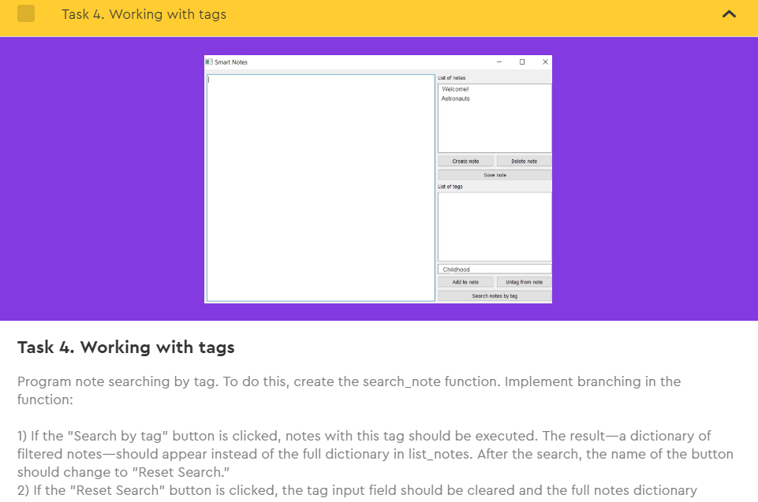
Do the task in VS Code
“VSC. The Smart Notes Application”
Complete “Task 4. Searching for notes by tag.”
Working in VS Code

Slide 71

Module 3. Lesson 3. The Smart Notes Application. P. 2
Wrapping up the work day

Slide 72


Additional task:
Create two notes about outer space
In Smart Notes and
attach tags to them.
Test your application independently or with a partner:
add one more note,
delete it,
search by tag.
Wrapping up
the work day

